Slide 1


Slide 2
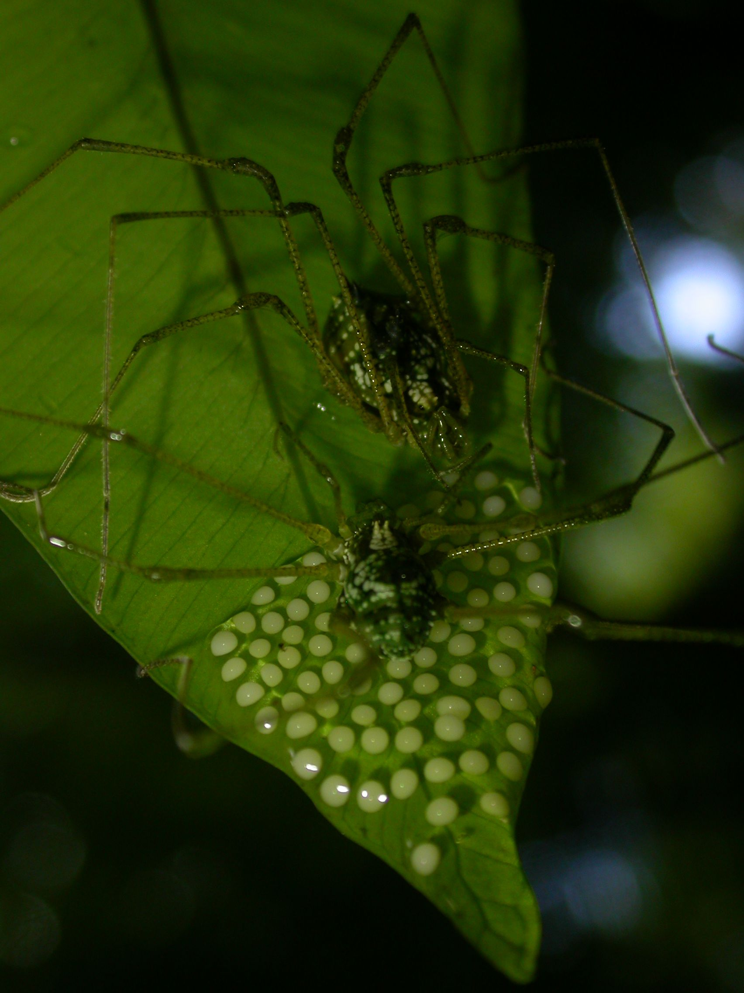
Demographic dynamics and evolution of parental care
Cinthia „the fixed point girl“
Cristian „less equations“
Danilo „not a spider“
Katharina „of the many colours and the pretty boxes“
Marcos „saving us from starvation“
Vitor „the evil spirit“
Group 5

Slide 3
Male parenting
Rare behaviour
Iporangaia
pustolosa

Slide 4
Caring males
Attract females
Increase offspring survival
Decreased body conditions
Non-caring males
Less attractive to females
Better body conditions

Slide 5

Questions
How does female preference affect the dynamics?
Is male parental care evolutionary stable?

Slide 6
hatching
abandon-
ment
death
N_{C}
N_{N}
death
mating
birth
Notes:
Problem: preference for caring males and deteriorating body conditions not possible to take into account

Slide 7

one model to rule them all

Slide 8
Male dynamics
r-f₁
r-f₂
rα
r-f_{k}
f₀
r
r
r
f₁
f₂
f_{k-1}
N_{N}
N_{C}⁽¹⁾
N_{C}⁽²⁾
N_{C}^{(k)}
γαp
μ
μ
μ
γ
μ
f – mating rate
r – fraction of hatching clutches
μ – death rate
γ – abandonment rate
α – number of viable male offspring per clutch
p – probability of survival for abandonned clutches

Slide 9
Mating
male mating pool:
N_{N}
N_{C}⁽¹⁾ * r
N_{C}⁽²⁾ * r
...
N_{C}^{(k-1)} * r
female mating pool:
F = ε * N_{t}
β₀
β₁
β₂
β_{k-1}
ε – fraction of available females
β_{i} – female preference for class i
Notes:
Number of matings in each class...

Slide 10
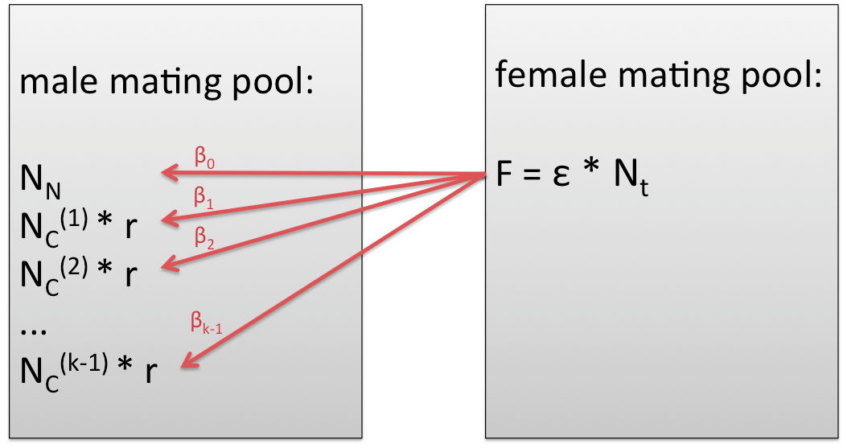
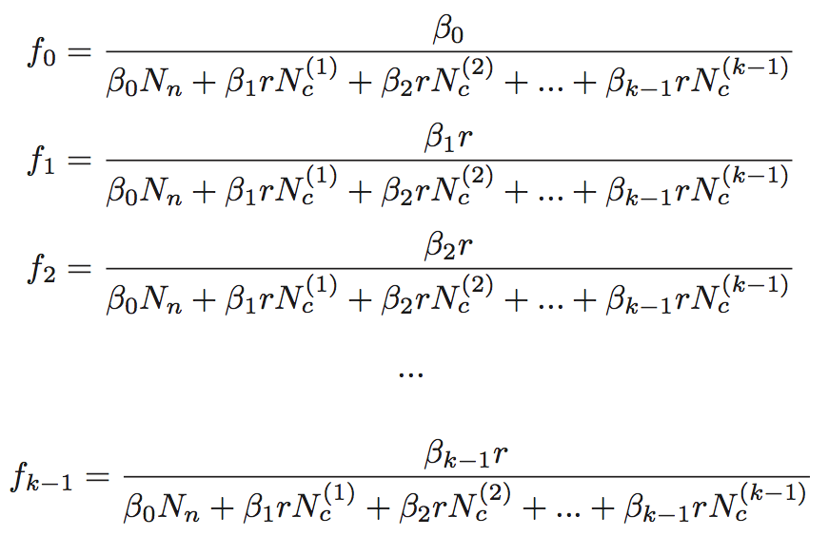
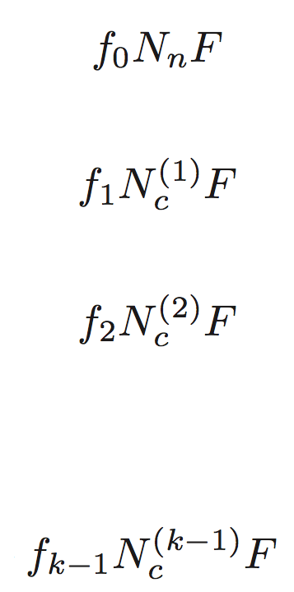
Mating
number of matings in each class:
where
=> sum of all matings = F

Slide 11
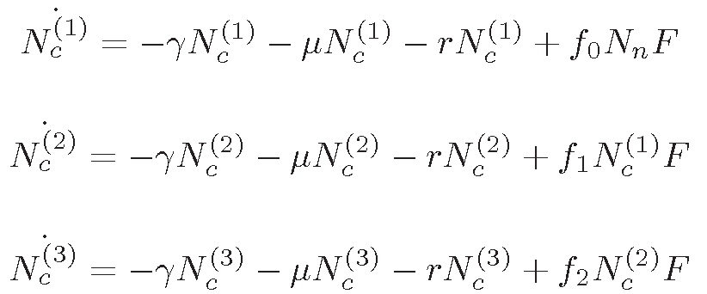

One model to rule them all
No analytical solutions
Numerical simulations
γ – abandonment rate
μ – death rate
r – fraction of hatching clutches
f – mating rate

Slide 12
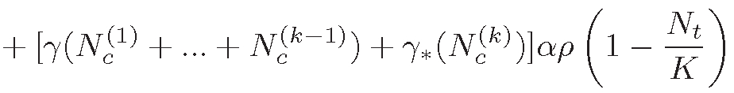
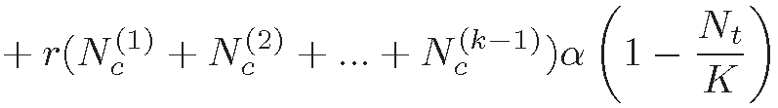

One model to rule them all
Abandonning males
Birth of abandoned eggs
Released males
Birth of cared eggs
Available females
α – number of viable male offspring per clutch
p – probability of survival for abandoned clutches
K – carrying capacity
ε – fraction of females available for mating

Slide 13
Assumptions
Death rate is
constant
Body condition does not affect male survival
Abandonment rates are constant
Last class always abandons
Mating rate is a function of female preference
Female availability is proportional to number of males
Each male has max. one
clutch at a time

Slide 14

Parameter values
r = 0.2
μ = 0.2
γ = 0.1
α =10
p =0.3
K= 500
ε = 0.3
β = varying

Slide 15
k = 3
b0 = b1 = b2 = 1

Slide 16
How does female preference affect the number of individuals in the caring classes?

Slide 17
How does female preference affect the number of individuals in the caring classes?

Slide 18
How does female preference affect the number of individuals in the caring classes?

Slide 19
How does female preference affect the number of individuals in the caring classes?

Slide 20
How does female preference affect the number of individuals in the caring classes?

Slide 21
How does female preference affect the number of individuals in the caring classes?

Slide 22
„class collapse“
NN = NN = NN = NN
NCt = NCt = NCt = NCt

Slide 23
„class collapse“
Abandonning males
Birth of abandoned eggs
Released males
Birth of cared eggs
= - F
Available females

Slide 24
„class collapse“
No analytical solutions
Numerical simulations
= F

Slide 25
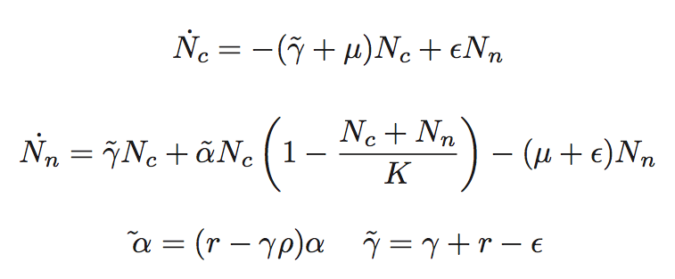
„class collapse“

Slide 26
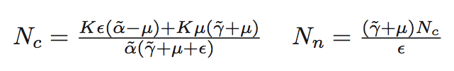
„class collapse“
Equilibria:
N_{c} = 0 N_{n} = 0
=> which fixed point is stable depends on parameters

Slide 27


Evolution of male care
Different mortality of abandoned eggs
Female preference (body condition & care)
two populations with three caring classes each
    2 times 4 equations
    different abandonment rates
  good fathers: gamma = 0.2
  bad fathers: gamma = 1

Slide 28
Evolution of care vs. egg mortality

Slide 29

dashed – bad fathers
solid – good fathers
=> good fathers go extinct
egg mortality = 0.2
gamma_{bad} = 0.8
gamma_{good} = 0.2

Slide 30
dashed – bad fathers
solid – good fathers
=> bad fathers go extinct
egg mortality = 0.2
gamma_{bad} = 0.8
gamma_{good} = 0.2

Slide 31
dashed – bad fathers
solid – good fathers
good fathers go extinct
equal to no preference
egg mortality = 0.2
gamma_{bad} = 0.8
gamma_{good} = 0.2

Slide 32
dashed – bad fathers
solid – good fathers
bad fathers go extinct
dynamics change
egg mortality = 0.2
gamma_{bad} = 0.8
gamma_{good} = 0.2

Slide 33
Conclusion
How does female preference affect the dynamics?
  no change in ratio of NN/NC
  change in the distribution of the NC-classes

Slide 34
Conclusions
Is male parental care evolutionary stable?
  success of parental care is dependent on survival rate of the abandoned eggs
  female preference can determine if „good“ or „bad“ fathers evolve

Slide 35
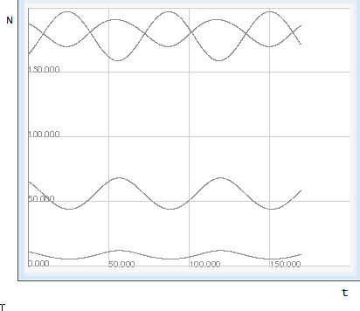
What’s next?
NN
NC1
NC2
NC3

Slide 36

My preciousss!!!

